Slide 1
IE Sight Mars Rover

Slide 2
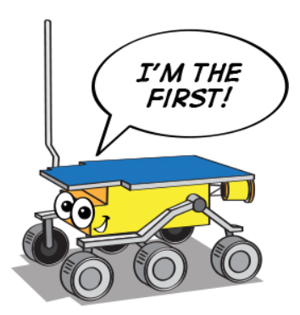
We will be looking into the
simulation of rover also the electrical
components required for building a rover

Slide 3

Computer Simulation
Using ROS

Slide 4
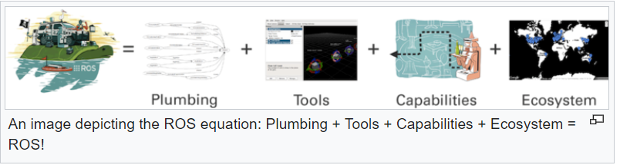
What is ROS ?
Robot Operating System (ROS or ros) is an open-source robotics middleware suite. Although ROS is not an operating system (OS) but a set of software frameworks for robot software development, it provides services designed for a heterogeneous computer cluster such as hardware abstraction, low-level device control, implementation of commonly used functionality, message-passing between processes, and package management.

Slide 5


Why do we need ROS to simulate ?
Robots are usually expensive and quite susceptible to damage and undesired interaction with themselves or their surroundings. Three-dimensional simulation is a sustainable method to test and rapidly iterate during robot application development.
Robot Operating System (ROS) is a middleware for multiple robot software tools and also provides simulation platforms like Rviz and Gazebo.

Slide 6
Understanding the process step by step:
First you have to make a environment for working with our project so for that we are creating a folder called catkin_ws.
Note:
Catkin_ws - “catkin_ws (could be called anything you want really, iesight_ws) is the workspace in which you want to develop your packages on. Inside the catkin_ws folder in the devel/ folder you will see a setup. “
Then using the command cd catkin_ws/src we have to change the directory to src of catkin_ws.
Then we have to import the GitHub project we are working on using git clone https://GitHub.com.
After importing the file we have to go back to catkin_ws directory and run the command catkin_make.
What is catkin_make:-
The catkin_make is actually a macro which creates directories and runs cmake command for you.

Slide 7
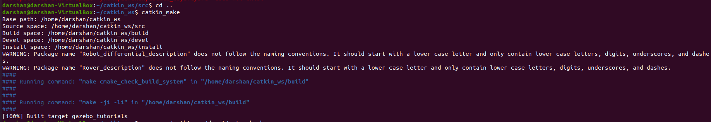
After making catkin we need to setup the devel with the code source ~/catkin_ws/devel/setup.bash
Purpose of sourcing the bash file from devel,
Reads and executes setup. bash script in the current shell.
After sourcing the bash file we have to launch the ros file from the folder using the command roslaunch ‘respective folder’ ‘launch file’

Slide 8
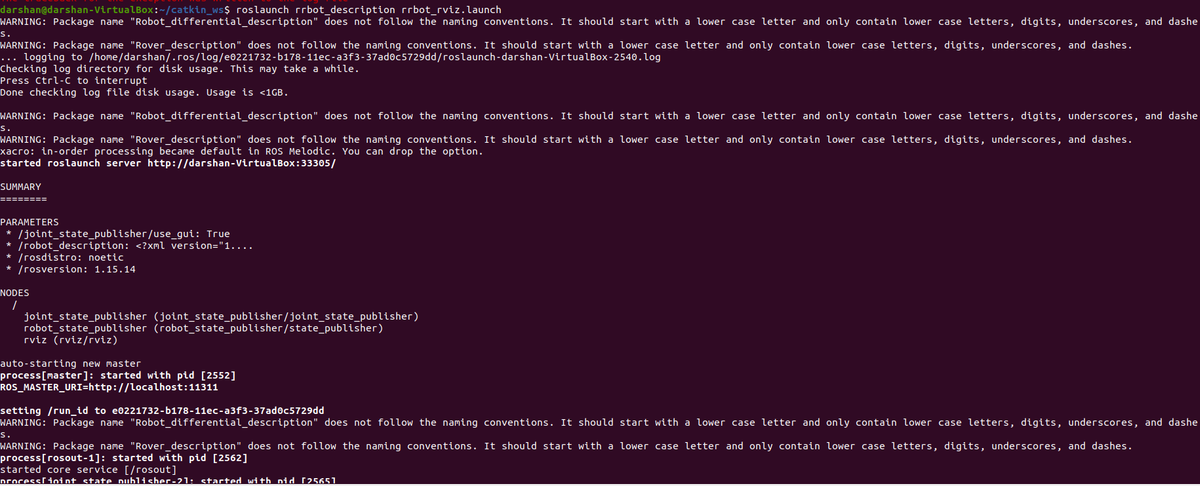
This is how the launch file works and this command launches the .launch file,

Slide 9
Electrical part of Mars rover

Slide 10
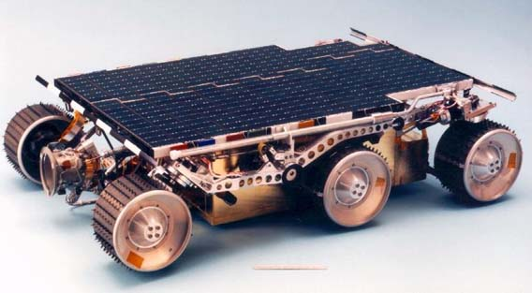
Components we used for IE Rover,
Lander.
Power system.
Locomotion system.
Hardware and software.
Communication and cameras.
Rover Control Software.
Alpha Proton X-Ray Spectrometer.
Wheel Abrasion Experiment.
Note: The above mentioned components are not complete electrical there are specific electrical components in each part of the rover.

Slide 11
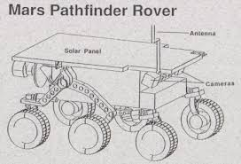
Power supply of our Rover,
Our rover is powered by a 0.22sqm solar panel comprised of 13 strings of 18, 5.5mil GaAs cells each.
The solar panel is backed up by 9 LiSOCL2 D-cell sized primary batteries, providing up to 150W-hr.
This combined panel/batteries system allows rover power users to draw up to 30W of peak power (mid-sol) while the peak panel production is 16W. The normal driving power requirement for the rover is 10W.

Slide 12
Vehicle motion control
The computer is an 80C85 rated at 100Kips which uses, in a 16Kbyte page swapping fashion, 176Kbytes of PROM and 576Kbytes of RAM. The computer performs I/O to some 70 sensor channels and services such devices as the cameras, modem, motors and experiment electronics
Vehicle motion control is accomplished through the on/off switching of the drive or steering motors. An average of motor encoder (drive) or potentiometer (steering) readings determines when to switch off the motors. When motors are off, the computer conducts a proximity and hazard detection function, using its laser striping and camera system to determine the presence of obstacles in its path.

Slide 13
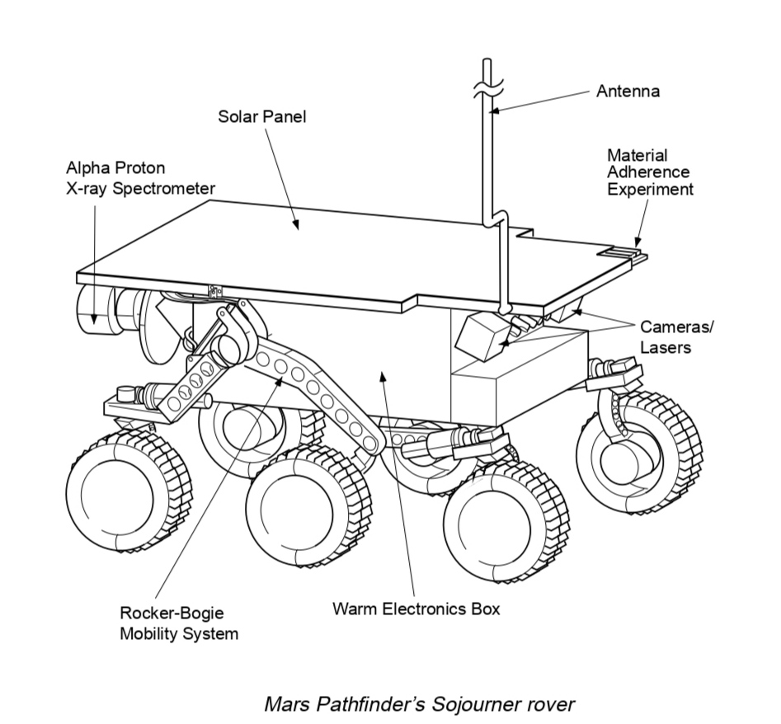
Sensors:
Three motion sensors along Sojourner’s frame can detect excessive tilt and stop the rover before it gets dangerously close to tipping over. IE Sight is capable of scaling a boulder on Mars that is more than 20 centimeters (8 inches) high and keep on going.
Provided images of the surrounding terrain for geological studies, and documented the performance and operating environment for Pathfinder mission technologies.

Slide 14
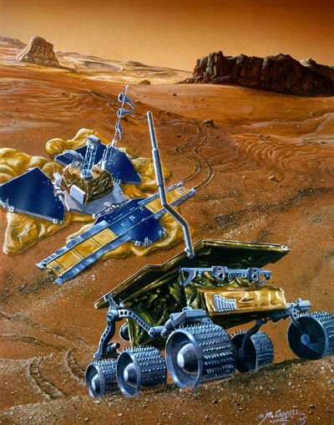
Science Instruments:-
Alpha Proton X-ray Spectrometer: Determined the elemental composition of rocks and soils.
Atmospheric Structure Instrument/Meteorology Package: Measured the Martian atmosphere during Pathfinder's descent to the surface, and provided meteorological measurements at the lander.

Slide 15
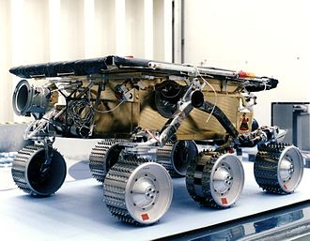
3D model of the perseverance made by NASA
https://mars.nasa.gov/resources/25042/mars-perseverance-rover-3d-model/
In this link you can find the 3D simulation of mars rover created by NASA.

Slide 16

Our core team:
Sooraj M.
Prasad G Maladkar.
Shunu P S.
Vedant Patel.
Jharana Awasthi.
Rahul Chaturvedi.
Thejaswi N.
Darshan S.
Karan Panchel.
Tusharr J S.

